Slide 1

Naive Bayes Variants: A Quick Reference Guide
Different data types require different approaches. Understanding which Naive Bayes variant to use can dramatically improve your classification results. Let's explore the three essential models every data scientist should know.

Slide 2
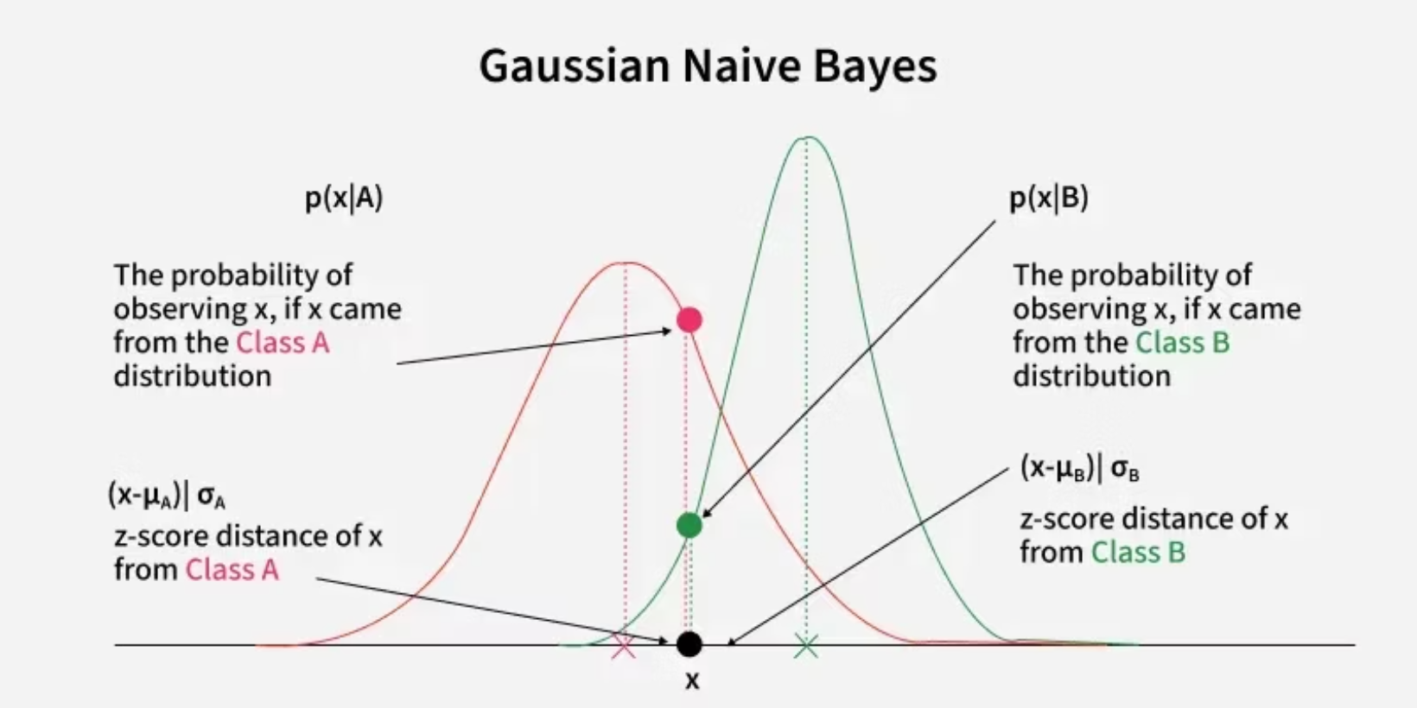
Gaussian Naive Bayes
What It Does
Designed specifically for continuous numerical features that follow a normal distribution. The algorithm assumes your data forms the classic bell curve pattern.
Common Features
Height and weight measurements
Temperature readings
Blood pressure values
Perfect Use Case
Sensor data streams
Medical diagnosis systems leverage Gaussian NB to classify patient conditions based on continuous vitals like heart rate, body temperature, and lab test results.

Slide 3
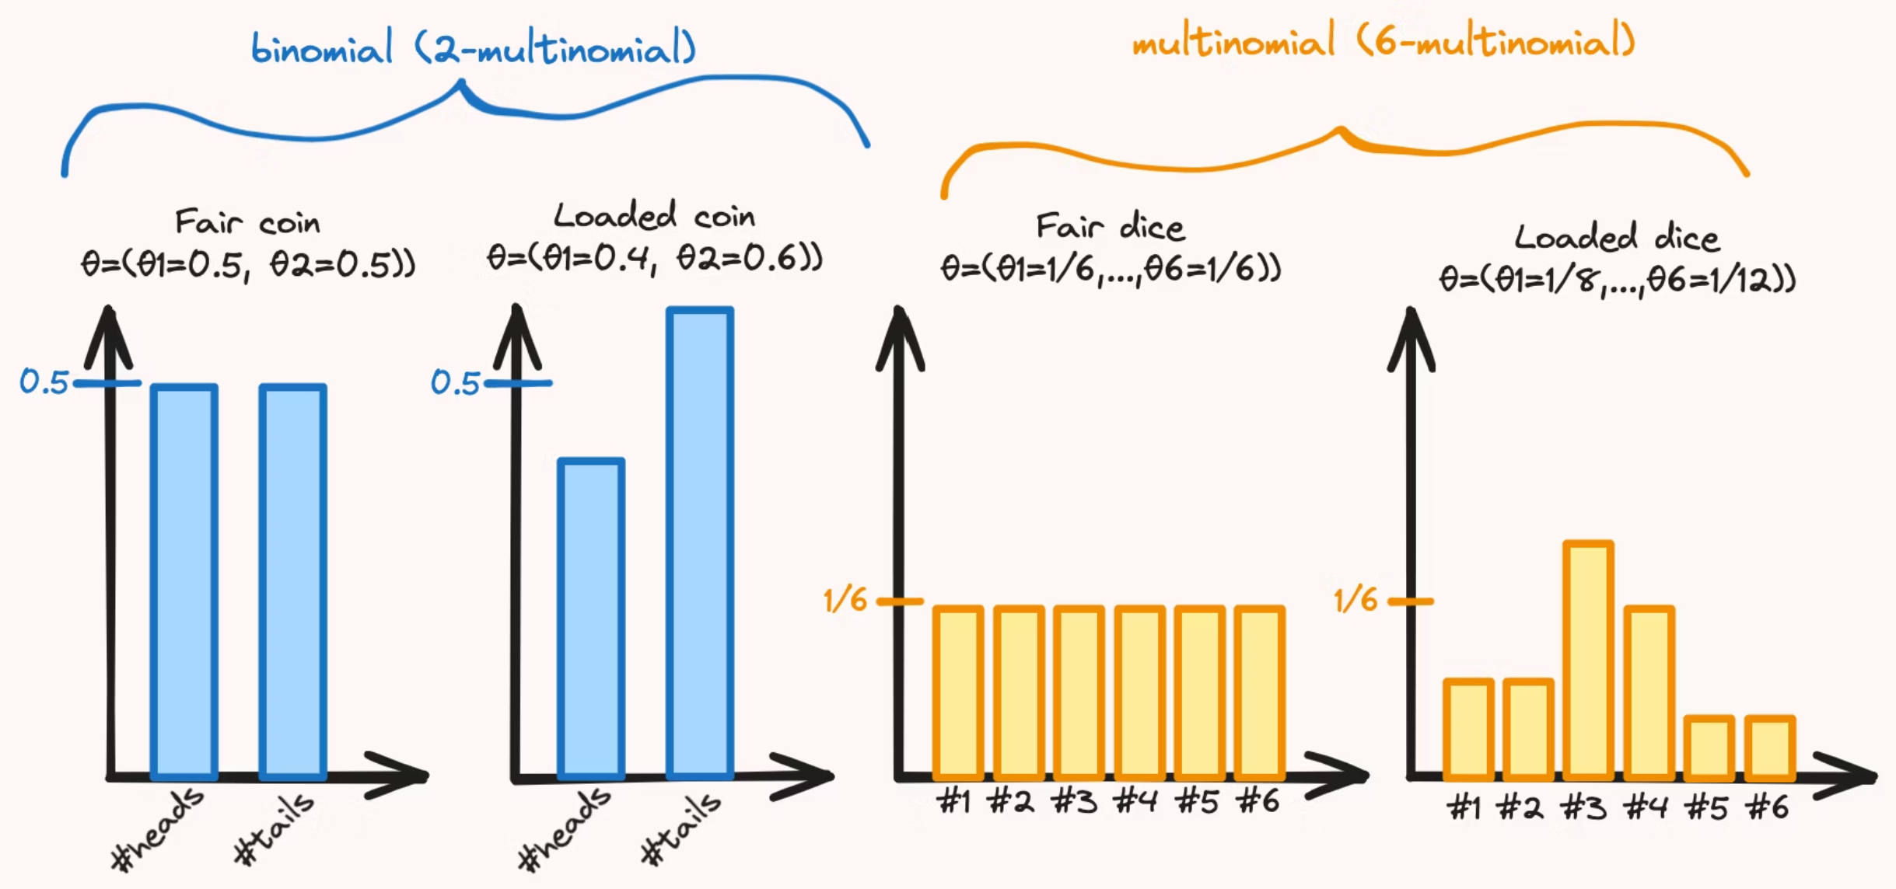
Multinomial Naive Bayes
How It Works
Typical Features
NLP Champion
Processes count-based features where frequency matters. Tracks how many times each feature appears, making it ideal for discrete data.
Word counts in documents, term frequencies in emails, occurrence counts of categorical events, and document-term matrices.
Text classification tasks are where Multinomial NB shines: spam detection, sentiment analysis, topic categorization, and document classification all benefit from its count-based approach.

Slide 4



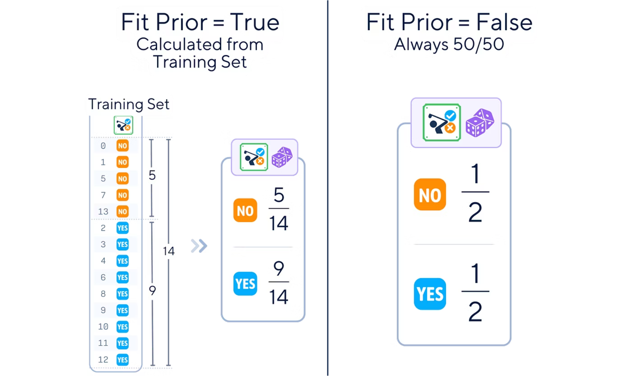
Bernoulli Naive Bayes
Binary Feature Specialist
Common Applications
When to Choose It
Handles features that can only be true or false, present or absent. The simplest but surprisingly powerful variant for specific use cases.
Word presence detection (not counting), binary text features, yes/no survey responses, and feature existence patterns.
Excellent for simple text classification where you only care whether a word appears, not how often. Think spam filters that flag based on presence of specific terms.

Slide 5
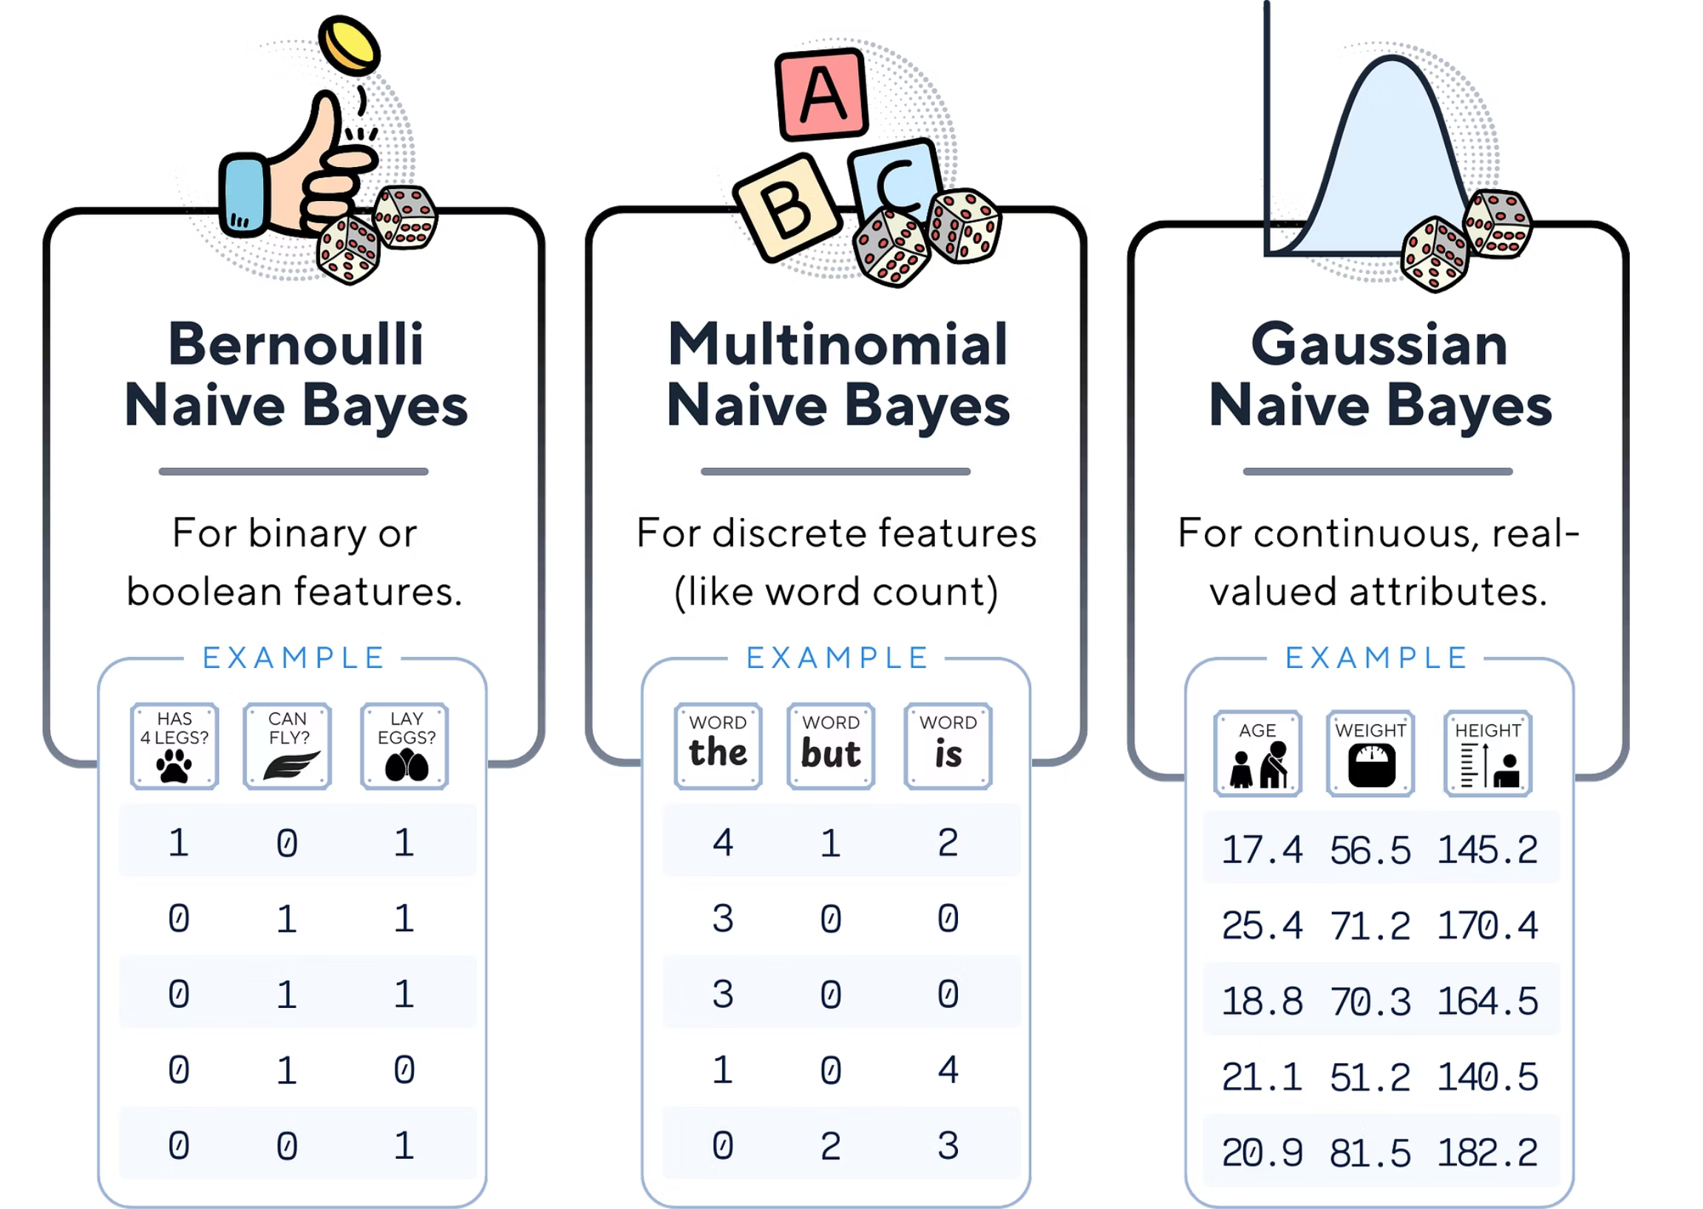
Choosing the Right Variant
Selecting the appropriate Naive Bayes variant is crucial for effective classification. Consider your data type and problem statement:
Gaussian Naive Bayes: Best for continuous data that follows a Gaussian (normal) distribution.
Multinomial Naive Bayes: Ideal for discrete features representing counts, such as word frequencies in text classification.
Bernoulli Naive Bayes: Suited for binary features, where only the presence or absence of a feature matters (e.g., whether a word appears in a document).
Aligning the variant with your data characteristics optimizes model performance and interpretability.

Slide 6



Quick Reference: Use Cases by Variant
Gaussian Naive Bayes
Multinomial Naive Bayes
Bernoulli Naive Bayes
Continuous numerical data: Medical diagnostics, sensor readings, scientific measurements, financial metrics, and any normally distributed features.
Count-based text data: Document classification, sentiment analysis, topic modeling, spam detection with word frequencies, and any discrete count features.
Binary text patterns: Simple spam filters, keyword presence detection, binary feature classification, and short text categorization tasks.

Slide 7





Decision Framework: Which Variant Should You Choose?
Let Your Data Decide
Text Data? Start with Multinomial
The choice isn't arbitrary—your feature types determine the best variant. Look at what you're measuring first.
For most NLP tasks with word counts or term frequencies, Multinomial is your default choice. It captures frequency patterns effectively.
Binary Patterns? Try Bernoulli
Numerical Measurements? Go Gaussian
When working with presence/absence features or short texts where you only care if a word exists, Bernoulli offers simplicity and speed.
Continuous features like sensor data, medical vitals, or scientific measurements call for Gaussian NB every time.
Pro tip: When in doubt, experiment! Run quick tests with different variants on a validation set. The performance metrics will reveal the best fit for your specific dataset.

